Slide 1
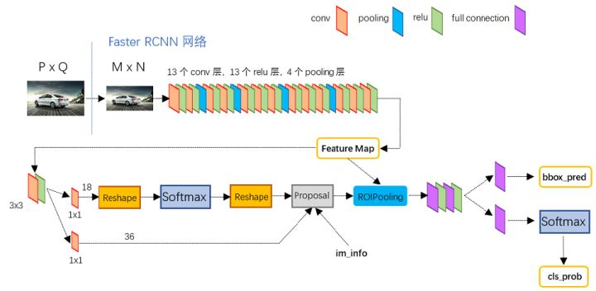
backbone: VGG16 without FC layers
backbone: Resnet50,
conv1-conv4
替换权重
res4b22
conv5
res4b22
rpn_bbox_pred
res4b22
rpn_conv/3x3
RoI Proposal
roi_pool5
extract feature: pool5_flat
rpn_bbox_pred
one-stage:RPN
two-stage: RoI pooling and classifier

